Slide 1
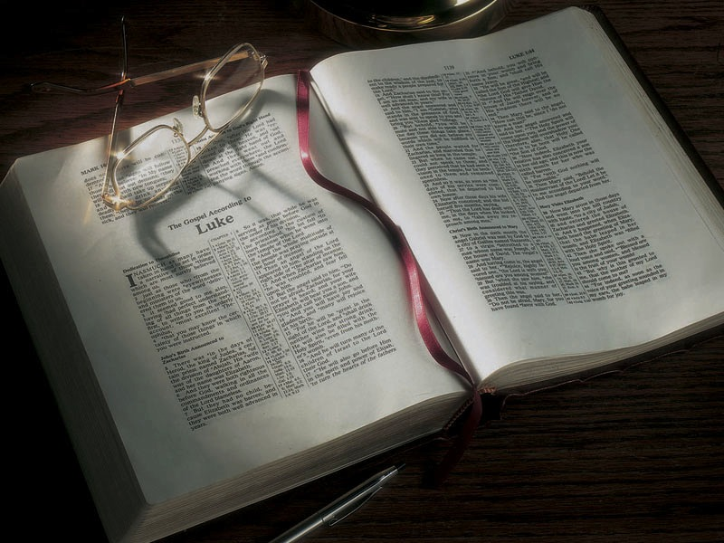

Slide 2
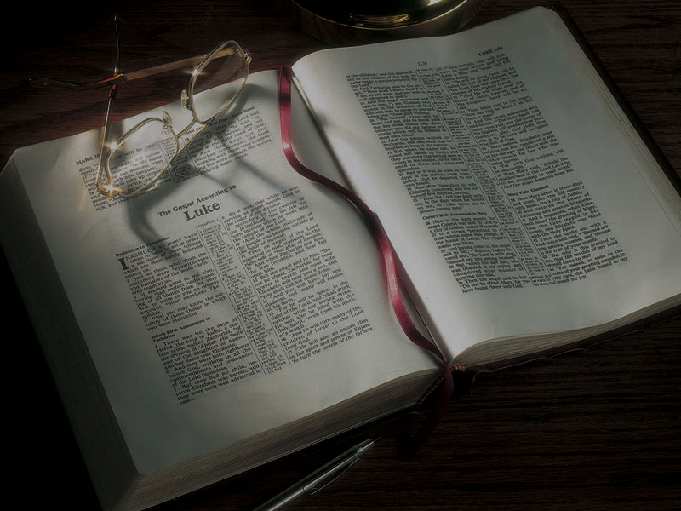
The Gospels
Jesus’ Relationship With the Father

Slide 3
John 5:16-23
16 For this reason the Jews persecuted Jesus, and sought to kill Him, because He had done these things on the Sabbath.
17 But Jesus answered them, “My Father has been working until now, and I have been working.”
18 Therefore the Jews sought all the more to kill Him, because He not only broke the Sabbath, but also said that God was His Father, making Himself equal with God.

Slide 4
John 5:16-23
19 Then Jesus answered and said to them, “Most assuredly, I say to you, the Son can do nothing of Himself, but what He sees the Father do; for whatever He does, the Son also does in like manner.
20 “For the Father loves the Son, and shows Him all things that He Himself does; and He will show Him greater works than these, that you may marvel.
21 “For as the Father raises the dead and gives life to them, even so the Son gives life to whom He will.

Slide 5
John 5:16-23
22 “For the Father judges no one, but has committed all judgment to the Son,
23 “that all should honor the Son just as they honor the Father. He who does not honor the Son does not honor the Father who sent Him.

Slide 6
John 5:16-23
16 For this reason the Jews persecuted Jesus, and sought to kill Him, because He had done these things on the Sabbath.
17 But Jesus answered them, “My Father has been working until now, and I have been working.”
18 Therefore the Jews sought all the more to kill Him, because He not only broke the Sabbath, but also said that God was His Father, making Himself equal with God.

Slide 7
John 3:2
2 This man [Nicodemus] came to Jesus by night and said to Him, “Rabbi, we know that You are a teacher come from God; for no one can do these signs that You do unless God is with him.”

Slide 8
John 5:16-23
16 For this reason the Jews persecuted Jesus, and sought to kill Him, because He had done these things on the Sabbath.
17 But Jesus answered them, “My Father has been working until now, and I have been working.”
18 Therefore the Jews sought all the more to kill Him, because He not only broke the Sabbath, but also said that God was His Father, making Himself equal with God.

Slide 9
John 5:17
NKJV: But Jesus answered them, “My Father has been working until now, and I have been working.”
NIV: “My Father is always at his work to this very day, and I, too, am working.”
ESV: “My Father is working until now, and I am working.”
HCSB: “My Father is still working, and I am working also.”
NLT: “My Father is always working, and so am I.”
NASB: “My Father is working until now, and I Myself am working.”

Slide 10
John 5:16-23
16 For this reason the Jews persecuted Jesus, and sought to kill Him, because He had done these things on the Sabbath.
17 But Jesus answered them, “My Father has been working until now, and I have been working.”
18 Therefore the Jews sought all the more to kill Him, because He not only broke the Sabbath, but also said that God was His Father, making Himself equal with God.

Slide 11
John 5:18
NKJV: Therefore the Jews sought all the more to kill Him, because He not only broke the Sabbath, but also said that God was His Father, making Himself equal with God.
NIV: For this reason the Jews tried all the harder to kill him; not only was he breaking the Sabbath, but he was even calling God his own Father, making himself equal with God.

Slide 12
John 5:16-23
ESV: This was why the Jews were seeking all the more to kill him, because not only was he breaking the Sabbath, but he was even calling God his own Father, making himself equal with God.
HCSB: This is why the Jews began trying all the more to kill Him: Not only was He breaking the Sabbath, but He was even calling God His own Father, making Himself equal with God.

Slide 13
John 5:16-23
ESV: This was why the Jews were seeking all the more to kill him, because not only was he breaking the Sabbath, but he was even calling God his own Father, making himself equal with God.
HCSB: This is why the Jews began trying all the more to kill Him: Not only was He breaking the Sabbath, but He was even calling God His own Father, making Himself equal with God.
Jesus had been doing this repeatedly before.

Slide 14
John 5:16-23
19 Then Jesus answered and said to them, “Most assuredly, I say to you, the Son can do nothing of Himself, but what He sees the Father do; for whatever He does, the Son also does in like manner.
20 “For the Father loves the Son, and shows Him all things that He Himself does; and He will show Him greater works than these, that you may marvel.
21 “For as the Father raises the dead and gives life to them, even so the Son gives life to whom He will.

Slide 15
Hebrews 1:2-3
2 [God the Father] has in these last days spoken to us by His Son, whom He has appointed heir of all things, through whom also He made the worlds;
3 who being the brightness of His glory and the express image of His person . . .
NIV: “the exact representation of his being . . .”

Slide 16
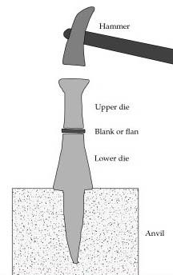

Slide 17
Hebrews 1:2-3
2 [God the Father] has in these last days spoken to us by His Son, whom He has appointed heir of all things, through whom also He made the worlds;
3 who being the brightness of His glory and the express image of His person . . .
NIV: “the exact representation of his being . . .”

Slide 19
Charakter

Slide 20
Character

Slide 21
1 Peter 2:21-23
21 For to this you were called, because Christ also suffered for us, leaving us an example, that you should follow His steps:
22 “Who committed no sin, Nor was deceit found in His mouth”;
23 who, when He was reviled, did not revile in return; when He suffered, He did not threaten, but committed Himself to Him who judges righteously;

Slide 22
John 5:16-23
19 Then Jesus answered and said to them, “Most assuredly, I say to you, the Son can do nothing of Himself, but what He sees the Father do; for whatever He does, the Son also does in like manner.
20 “For the Father loves the Son, and shows Him all things that He Himself does; and He will show Him greater works than these, that you may marvel.
21 “For as the Father raises the dead and gives life to them, even so the Son gives life to whom He will.

Slide 23
Isaiah 35:5-6
5 Then the eyes of the blind shall be opened, and the ears of the deaf shall be unstopped.
6 Then the lame shall leap like a deer, and the tongue of the dumb sing. For waters shall burst forth in the wilderness, and streams in the desert.

Slide 24
John 5:16-23
19 Then Jesus answered and said to them, “Most assuredly, I say to you, the Son can do nothing of Himself, but what He sees the Father do; for whatever He does, the Son also does in like manner.
20 “For the Father loves the Son, and shows Him all things that He Himself does; and He will show Him greater works than these, that you may marvel.
21 “For as the Father raises the dead and gives life to them, even so the Son gives life to whom He will.

Slide 25
John 10:10
10 I have come that they may have life, and that they may have it more abundantly.

Slide 26
John 5:16-23
19 Then Jesus answered and said to them, “Most assuredly, I say to you, the Son can do nothing of Himself, but what He sees the Father do; for whatever He does, the Son also does in like manner.
20 “For the Father loves the Son, and shows Him all things that He Himself does; and He will show Him greater works than these, that you may marvel.
21 “For as the Father raises the dead and gives life to them, even so the Son gives life to whom He will.

Slide 27
Deuteronomy 32:39
39 ‘Now see that I, even I, am He, and there is no God besides Me; I kill and I make alive; I wound and I heal; nor is there any who can deliver from My hand.

Slide 28
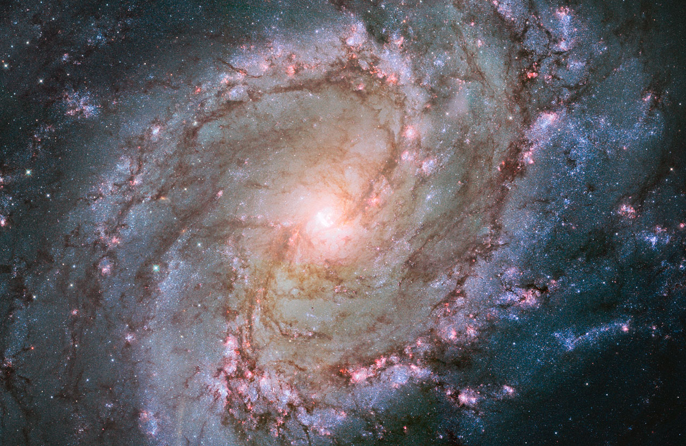

Slide 29
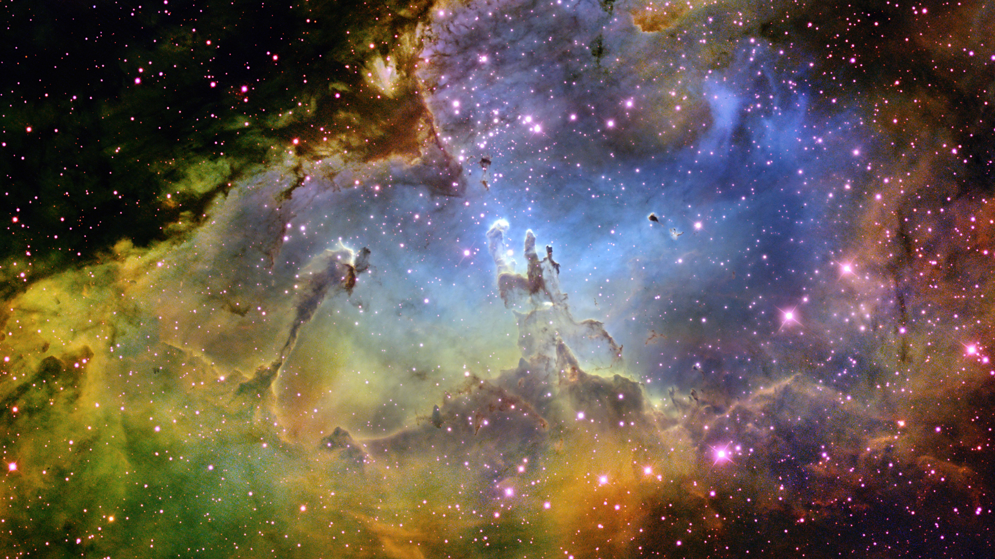

Slide 30
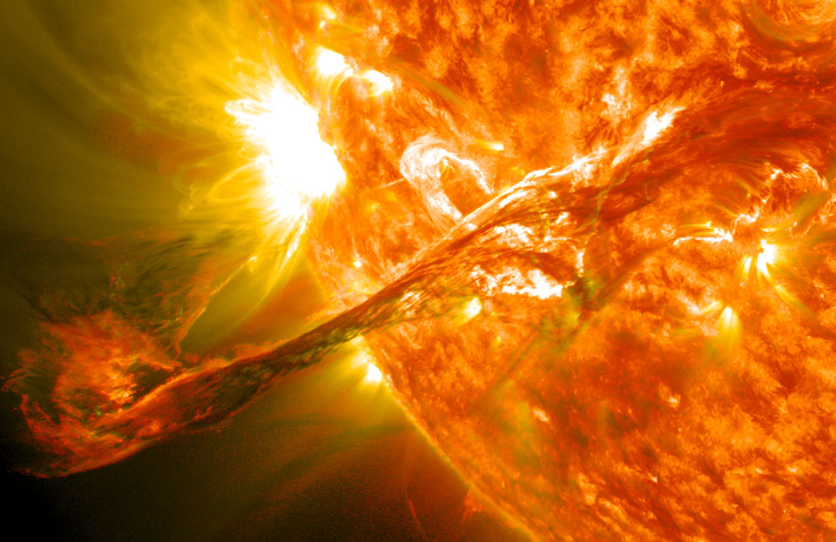

Slide 31
John 5:16-23
22 “For the Father judges no one, but has committed all judgment to the Son,
23 “that all should honor the Son just as they honor the Father. He who does not honor the Son does not honor the Father who sent Him.
24 “Most assuredly, I say to you, he who hears My word and believes in Him who sent Me has everlasting life, and shall not come into judgment, but has passed from death into life.

Slide 32
Psalm 28:8
8 Arise, O God, judge the earth; for You shall inherit all nations.
Isaiah 66:16
16 For by fire and by His sword the LORD will judge all flesh . . .
Joel 3:2
2 Let the nations be wakened, and come up to the Valley of Jehoshaphat; for there I will sit to judge all the surrounding nations.

Slide 33
John 5:16-23
22 “For the Father judges no one, but has committed all judgment to the Son,
23 “that all should honor the Son just as they honor the Father. He who does not honor the Son does not honor the Father who sent Him.
24 “Most assuredly, I say to you, he who hears My word and believes in Him who sent Me has everlasting life, and shall not come into judgment, but has passed from death into life.

Slide 34
Hebrews 4:15
15 For we do not have a High Priest who cannot sympathize with our weaknesses, but was in all points tempted as we are, yet without sin.
Hebrews 2:17-18
17 Therefore, in all things He had to be made like His brethren, that He might be a merciful and faithful High Priest in things pertaining to God, to make propitiation for the sins of the people.
18 For in that He Himself has suffered, being tempted, He is able to aid those who are tempted.

Slide 35
John 5:16-23
22 “For the Father judges no one, but has committed all judgment to the Son,
23 “that all should honor the Son just as they honor the Father. He who does not honor the Son does not honor the Father who sent Him.

Slide 38
John 5:16-47
16 For this reason the Jews persecuted Jesus, and sought to kill Him, because He had done these things on the Sabbath.
17 But Jesus answered them, “My Father has been working until now, and I have been working.”
18 Therefore the Jews sought all the more to kill Him, because He not only broke the Sabbath, but also said that God was His Father, making Himself equal with God.
19 Then Jesus answered and said to them, “Most assuredly, I say to you, the Son can do nothing of Himself, but what He sees the Father do; for whatever He does, the Son also does in like manner.
20 “For the Father loves the Son, and shows Him all things that He Himself does; and He will show Him greater works than these, that you may marvel.
21 “For as the Father raises the dead and gives life to them, even so the Son gives life to whom He will.
22 “For the Father judges no one, but has committed all judgment to the Son,
judgment also, because He is the Son of Man.
23 “that all should honor the Son just as they honor the Father. He who does not honor the Son does not honor the Father who sent Him.
24 “Most assuredly, I say to you, he who hears My word and believes in Him who sent Me has everlasting life, and shall not come into judgment, but has passed from death into life.
25 “Most assuredly, I say to you, the hour is coming, and now is, when the dead will hear the voice of the Son of God; and those who hear will live.
26 “For as the Father has life in Himself, so He has granted the Son to have life in Himself,
27 “and has given Him authority to execute judgment also, because He is the Son of Man.
28 “Do not marvel at this; for the hour is coming in which all who are in the graves will hear His voice
29 “and come forth—those who have done good, to the resurrection of life, and those who have done evil, to the resurrection of condemnation.
30 “I can of Myself do nothing. As I hear, I judge; and My judgment is righteous, because I do not seek My own will but the will of the Father who sent Me.
31 “If I bear witness of Myself, My witness is not true.
32 “There is another who bears witness of Me, and I know that the witness which He witnesses of Me is true.
33 “You have sent to John, and he has borne witness to the truth.
34 “Yet I do not receive testimony from man, but I say these things that you may be saved.
35 “He was the burning and shining lamp, and you were willing for a time to rejoice in his light.
36 “But I have a greater witness than John’s; for the works which the Father has given Me to finish—the very works that I do—bear witness of Me, that the Father has sent Me.
37 “And the Father Himself, who sent Me, has testified of Me. You have neither heard His voice at any time, nor seen His form.
38 “But you do not have His word abiding in you, because whom He sent, Him you do not believe.
39 “You search the Scriptures, for in them you think you have eternal life; and these are they which testify of Me.
40 “But you are not willing to come to Me that you may have life.
41 “I do not receive honor from men.
42 “But I know you, that you do not have the love of God in you.
43 “I have come in My Father’s name, and you do not receive Me; if another comes in his own name, him you will receive.
44 “How can you believe, who receive honor from one another, and do not seek the honor that comes from the only God?
45 “Do not think that I shall accuse you to the Father; there is one who accuses you—Moses, in whom you trust.
46 “For if you believed Moses, you would believe Me; for he wrote about Me.
47 “But if you do not believe his writings, how will you believe My words?”

Slide 39
John 5:16-47
16 For this reason the Jews persecuted Jesus, and sought to kill Him, because He had done these things on the Sabbath.
17 But Jesus answered them, “My Father has been working until now, and I have been working.”
18 Therefore the Jews sought all the more to kill Him, because He not only broke the Sabbath, but also said that God was His Father, making Himself equal with God.
19 Then Jesus answered and said to them, “Most assuredly, I say to you, the Son can do nothing of Himself, but what He sees the Father do; for whatever He does, the Son also does in like manner.
20 “For the Father loves the Son, and shows Him all things that He Himself does; and He will show Him greater works than these, that you may marvel.
21 “For as the Father raises the dead and gives life to them, even so the Son gives life to whom He will.
22 “For the Father judges no one, but has committed all judgment to the Son,
judgment also, because He is the Son of Man.
23 “that all should honor the Son just as they honor the Father. He who does not honor the Son does not honor the Father who sent Him.
24 “Most assuredly, I say to you, he who hears My word and believes in Him who sent Me has everlasting life, and shall not come into judgment, but has passed from death into life.
25 “Most assuredly, I say to you, the hour is coming, and now is, when the dead will hear the voice of the Son of God; and those who hear will live.
26 “For as the Father has life in Himself, so He has granted the Son to have life in Himself,
27 “and has given Him authority to execute judgment also, because He is the Son of Man.
28 “Do not marvel at this; for the hour is coming in which all who are in the graves will hear His voice
29 “and come forth—those who have done good, to the resurrection of life, and those who have done evil, to the resurrection of condemnation.
30 “I can of Myself do nothing. As I hear, I judge; and My judgment is righteous, because I do not seek My own will but the will of the Father who sent Me.
31 “If I bear witness of Myself, My witness is not true.
32 “There is another who bears witness of Me, and I know that the witness which He witnesses of Me is true.
33 “You have sent to John, and he has borne witness to the truth.
34 “Yet I do not receive testimony from man, but I say these things that you may be saved.
35 “He was the burning and shining lamp, and you were willing for a time to rejoice in his light.
36 “But I have a greater witness than John’s; for the works which the Father has given Me to finish—the very works that I do—bear witness of Me, that the Father has sent Me.
37 “And the Father Himself, who sent Me, has testified of Me. You have neither heard His voice at any time, nor seen His form.
38 “But you do not have His word abiding in you, because whom He sent, Him you do not believe.
39 “You search the Scriptures, for in them you think you have eternal life; and these are they which testify of Me.
40 “But you are not willing to come to Me that you may have life.
41 “I do not receive honor from men.
42 “But I know you, that you do not have the love of God in you.
43 “I have come in My Father’s name, and you do not receive Me; if another comes in his own name, him you will receive.
44 “How can you believe, who receive honor from one another, and do not seek the honor that comes from the only God?
45 “Do not think that I shall accuse you to the Father; there is one who accuses you—Moses, in whom you trust.
46 “For if you believed Moses, you would believe Me; for he wrote about Me.
47 “But if you do not believe his writings, how will you believe My words?”

Slide 40
John 5:16-47
16 For this reason the Jews persecuted Jesus, and sought to kill Him, because He had done these things on the Sabbath.
17 But Jesus answered them, “My Father has been working until now, and I have been working.”
18 Therefore the Jews sought all the more to kill Him, because He not only broke the Sabbath, but also said that God was His Father, making Himself equal with God.
19 Then Jesus answered and said to them, “Most assuredly, I say to you, the Son can do nothing of Himself, but what He sees the Father do; for whatever He does, the Son also does in like manner.
20 “For the Father loves the Son, and shows Him all things that He Himself does; and He will show Him greater works than these, that you may marvel.
21 “For as the Father raises the dead and gives life to them, even so the Son gives life to whom He will.
22 “For the Father judges no one, but has committed all judgment to the Son,
judgment also, because He is the Son of Man.
23 “that all should honor the Son just as they honor the Father. He who does not honor the Son does not honor the Father who sent Him.
24 “Most assuredly, I say to you, he who hears My word and believes in Him who sent Me has everlasting life, and shall not come into judgment, but has passed from death into life.
25 “Most assuredly, I say to you, the hour is coming, and now is, when the dead will hear the voice of the Son of God; and those who hear will live.
26 “For as the Father has life in Himself, so He has granted the Son to have life in Himself,
27 “and has given Him authority to execute judgment also, because He is the Son of Man.
28 “Do not marvel at this; for the hour is coming in which all who are in the graves will hear His voice
29 “and come forth—those who have done good, to the resurrection of life, and those who have done evil, to the resurrection of condemnation.
30 “I can of Myself do nothing. As I hear, I judge; and My judgment is righteous, because I do not seek My own will but the will of the Father who sent Me.
31 “If I bear witness of Myself, My witness is not true.
32 “There is another who bears witness of Me, and I know that the witness which He witnesses of Me is true.
33 “You have sent to John, and he has borne witness to the truth.
34 “Yet I do not receive testimony from man, but I say these things that you may be saved.
35 “He was the burning and shining lamp, and you were willing for a time to rejoice in his light.
36 “But I have a greater witness than John’s; for the works which the Father has given Me to finish—the very works that I do—bear witness of Me, that the Father has sent Me.
37 “And the Father Himself, who sent Me, has testified of Me. You have neither heard His voice at any time, nor seen His form.
38 “But you do not have His word abiding in you, because whom He sent, Him you do not believe.
39 “You search the Scriptures, for in them you think you have eternal life; and these are they which testify of Me.
40 “But you are not willing to come to Me that you may have life.
41 “I do not receive honor from men.
42 “But I know you, that you do not have the love of God in you.
43 “I have come in My Father’s name, and you do not receive Me; if another comes in his own name, him you will receive.
44 “How can you believe, who receive honor from one another, and do not seek the honor that comes from the only God?
45 “Do not think that I shall accuse you to the Father; there is one who accuses you—Moses, in whom you trust.
46 “For if you believed Moses, you would believe Me; for he wrote about Me.
47 “But if you do not believe his writings, how will you believe My words?”

Slide 41
John 5:16-47
16 For this reason the Jews persecuted Jesus, and sought to kill Him, because He had done these things on the Sabbath.
17 But Jesus answered them, “My Father has been working until now, and I have been working.”
18 Therefore the Jews sought all the more to kill Him, because He not only broke the Sabbath, but also said that God was His Father, making Himself equal with God.
19 Then Jesus answered and said to them, “Most assuredly, I say to you, the Son can do nothing of Himself, but what He sees the Father do; for whatever He does, the Son also does in like manner.
20 “For the Father loves the Son, and shows Him all things that He Himself does; and He will show Him greater works than these, that you may marvel.
21 “For as the Father raises the dead and gives life to them, even so the Son gives life to whom He will.
22 “For the Father judges no one, but has committed all judgment to the Son,
judgment also, because He is the Son of Man.
23 “that all should honor the Son just as they honor the Father. He who does not honor the Son does not honor the Father who sent Him.
24 “Most assuredly, I say to you, he who hears My word and believes in Him who sent Me has everlasting life, and shall not come into judgment, but has passed from death into life.
25 “Most assuredly, I say to you, the hour is coming, and now is, when the dead will hear the voice of the Son of God; and those who hear will live.
26 “For as the Father has life in Himself, so He has granted the Son to have life in Himself,
27 “and has given Him authority to execute judgment also, because He is the Son of Man.
28 “Do not marvel at this; for the hour is coming in which all who are in the graves will hear His voice
29 “and come forth—those who have done good, to the resurrection of life, and those who have done evil, to the resurrection of condemnation.
30 “I can of Myself do nothing. As I hear, I judge; and My judgment is righteous, because I do not seek My own will but the will of the Father who sent Me.
31 “If I bear witness of Myself, My witness is not true.
32 “There is another who bears witness of Me, and I know that the witness which He witnesses of Me is true.
33 “You have sent to John, and he has borne witness to the truth.
34 “Yet I do not receive testimony from man, but I say these things that you may be saved.
35 “He was the burning and shining lamp, and you were willing for a time to rejoice in his light.
36 “But I have a greater witness than John’s; for the works which the Father has given Me to finish—the very works that I do—bear witness of Me, that the Father has sent Me.
37 “And the Father Himself, who sent Me, has testified of Me. You have neither heard His voice at any time, nor seen His form.
38 “But you do not have His word abiding in you, because whom He sent, Him you do not believe.
39 “You search the Scriptures, for in them you think you have eternal life; and these are they which testify of Me.
40 “But you are not willing to come to Me that you may have life.
41 “I do not receive honor from men.
42 “But I know you, that you do not have the love of God in you.
43 “I have come in My Father’s name, and you do not receive Me; if another comes in his own name, him you will receive.
44 “How can you believe, who receive honor from one another, and do not seek the honor that comes from the only God?
45 “Do not think that I shall accuse you to the Father; there is one who accuses you—Moses, in whom you trust.
46 “For if you believed Moses, you would believe Me; for he wrote about Me.
47 “But if you do not believe his writings, how will you believe My words?”

Slide 42
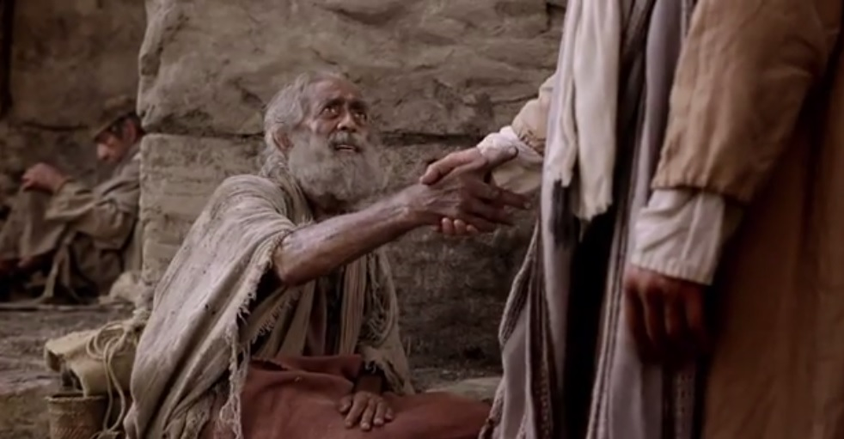

Slide 43
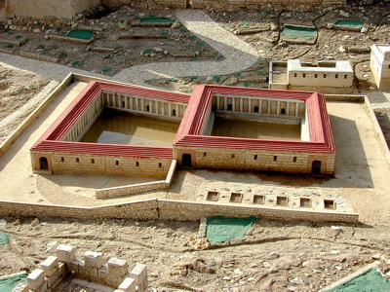

Slide 44
John 5:1-18
5 Now a certain man was there who had an infirmity thirty-eight years.
6 When Jesus saw him lying there, and knew that he already had been in that condition a long time, He said to him, “Do you want to be made well?”
7 The sick man answered Him, “Sir, I have no man to put me into the pool when the water is stirred up; but while I am coming, another steps down before me.”
8 Jesus said to him, “Rise, take up your bed and walk.”

Slide 45
John 5:1-18
9 And immediately the man was made well, took up his bed, and walked. And that day was the Sabbath.
10 The Jews therefore said to him who was cured, “It is the Sabbath; it is not lawful for you to carry your bed.”
11 He answered them, “He who made me well said to me, ‘Take up your bed and walk.’”
12 Then they asked him, “Who is the Man who said to you, ‘Take up your bed and walk’?”

